Slide 1

State Design Pattern

Slide 2
Difinition
A state design pattern is used when an Object changes its behavior based on its internal state
Also, by implementing it, the code should remain cleaner without many if/else statements.

Slide 3
Major component
Context: Defines an interface for clients to interact. It maintains references to concrete state objects which may be used to define the current state of objects.
State: Defines interface for declaring what each concrete state should do.
ConcreteState: Provides the implementation for methods defined in State.

Slide 4
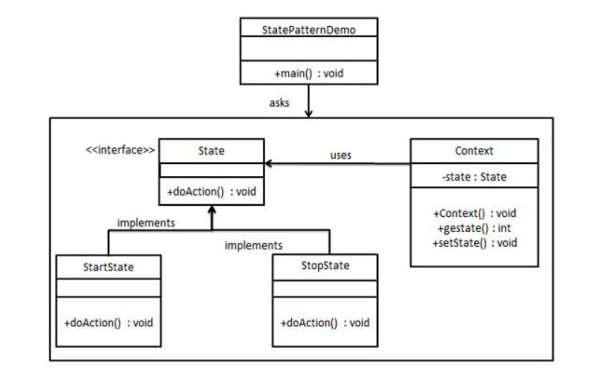
UML diagram

Slide 5
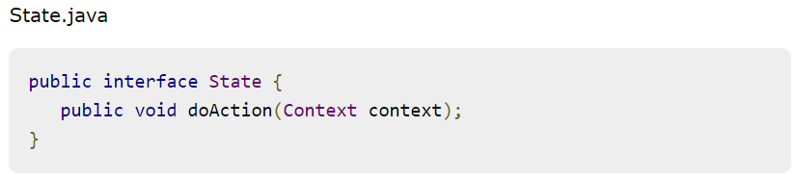
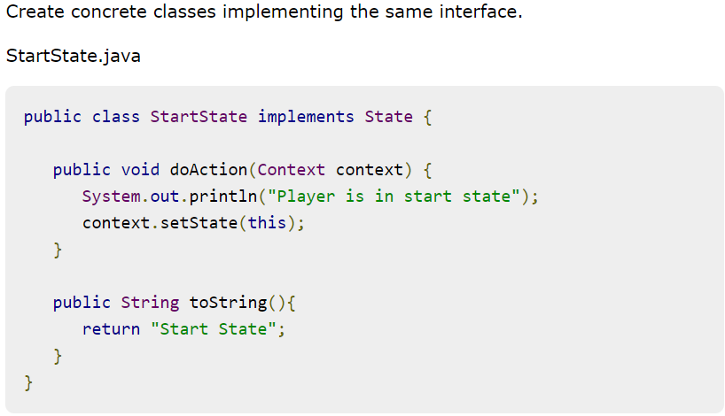
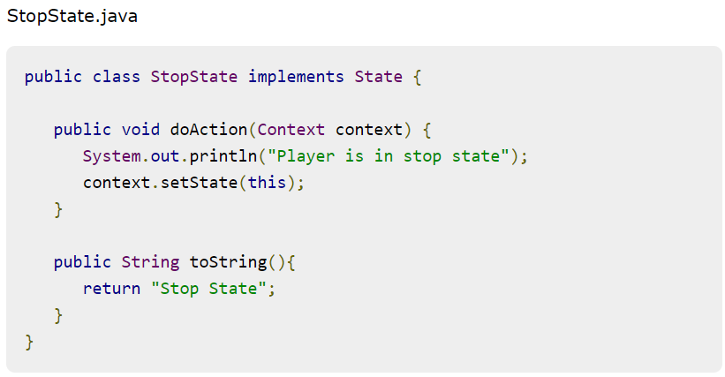
Example:

Slide 6
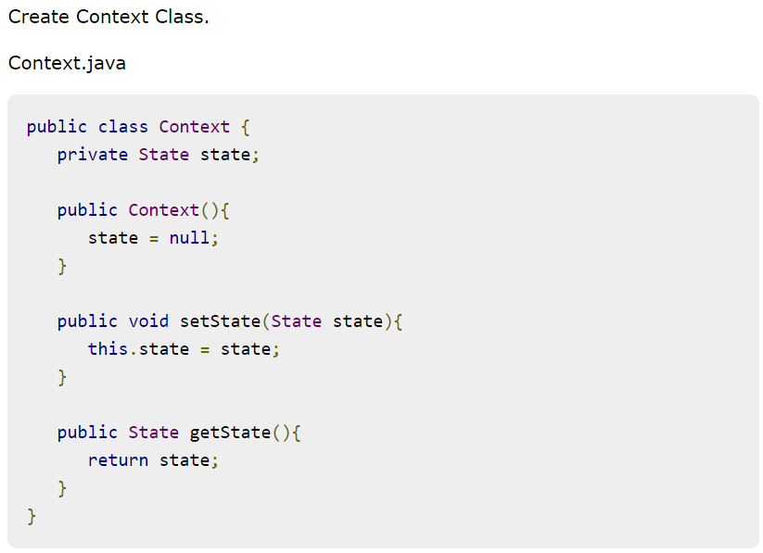

Slide 7
